Slide 1
.NET Core Web API including SOLID and Design Patterns
Marko Mitic, .Net Software Developer
Katarina Ivosevic, .Net Software Developer
Microsoft Teams
05/25/2021

Slide 2
Agenda
01
05
About us
Design Patterns
02
06
.NET Core
Refactoring
03
07
Web API
Conclusion
04
08
SOLID Principles
Questions

Slide 3

About us
01
Marko Mitic
.Net Software Developer

Slide 4

About us
01
Katarina Ivosevic
.Net Software Developer

Slide 5
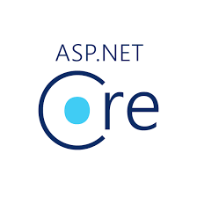

.NET Core
02

Slide 6
.NET 5 ecosystem
The .NET Framework is a development platform for application which provides services like building, deploying and running applications of desktop, web, and phone and web services
.NET Framework
Maintaining and upgrading existing .NET apps
Build and release something fast
There will be no more new versions of .NET Framework planned in the future
.NET Core
Better suited for cross-platform needs
Modularity lightweight, and flexibility makes it easier to deploy .NET Core apps in containers
Will continue to get better and better

Slide 7
c# fundamentals
Data types
Value types
Reference types
Pointer types
Loop types
While loop
Do…while loop
For loop
Nested loop
Decision statements
If statement
If…else statement
Nested if statement
Switch statement
Nested switch statement
Control statements
Continue statement
Control statement
Encapsulation
Public
Private
Protected
Internal
Protected internal
Polymorphism
Static
Dynamic

Slide 8
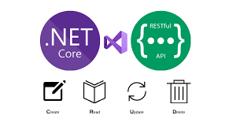
Web api
03

Slide 9
api
Api is a concept which has a set of functions which allow programers to access specific features or data of a system
Web API is an API over the web which can be accessed using HTTP protocol
ASP .NET Web API is an extensible framework for building HTTP based services that can be accessed in different applications on different platforms
REST API is client-server, stateless, cacheable, uniform interface, layered system architectural style

Slide 10
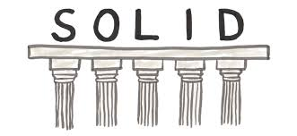
Solid principles
04

Slide 11
SOLID Principles
SOLID principles in C# are basic design principles. They enable us to write easily managed, adaptable to changes and testable code
Single Responsibility Principle
Open-closed Principle
Liskov Substitution Principle
Interface Segregation Principle
Dependency Inversion Principle

Slide 12

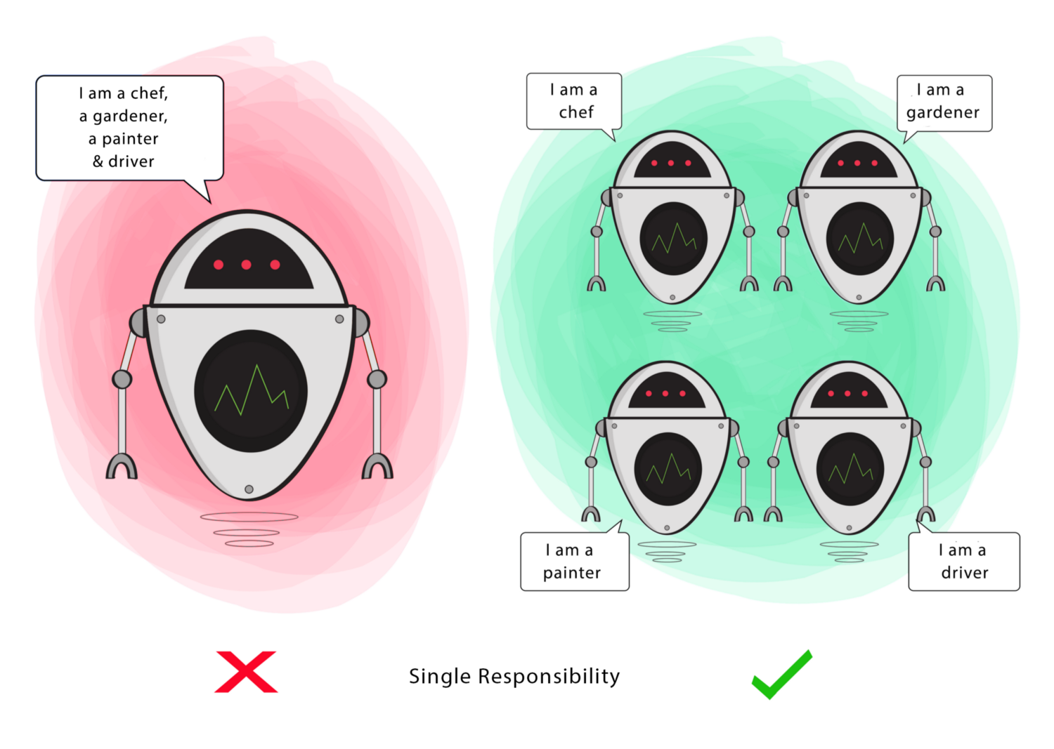
Single responsibility principle
“Each module has one and only one reason for change”
If the module has many responsibilites, it increases the possibility of bugs. This pinciple’s goal is to separate behaviour so that if bugs arise as a result of your change, it won’t affect other unrelated behaviours.

Slide 13

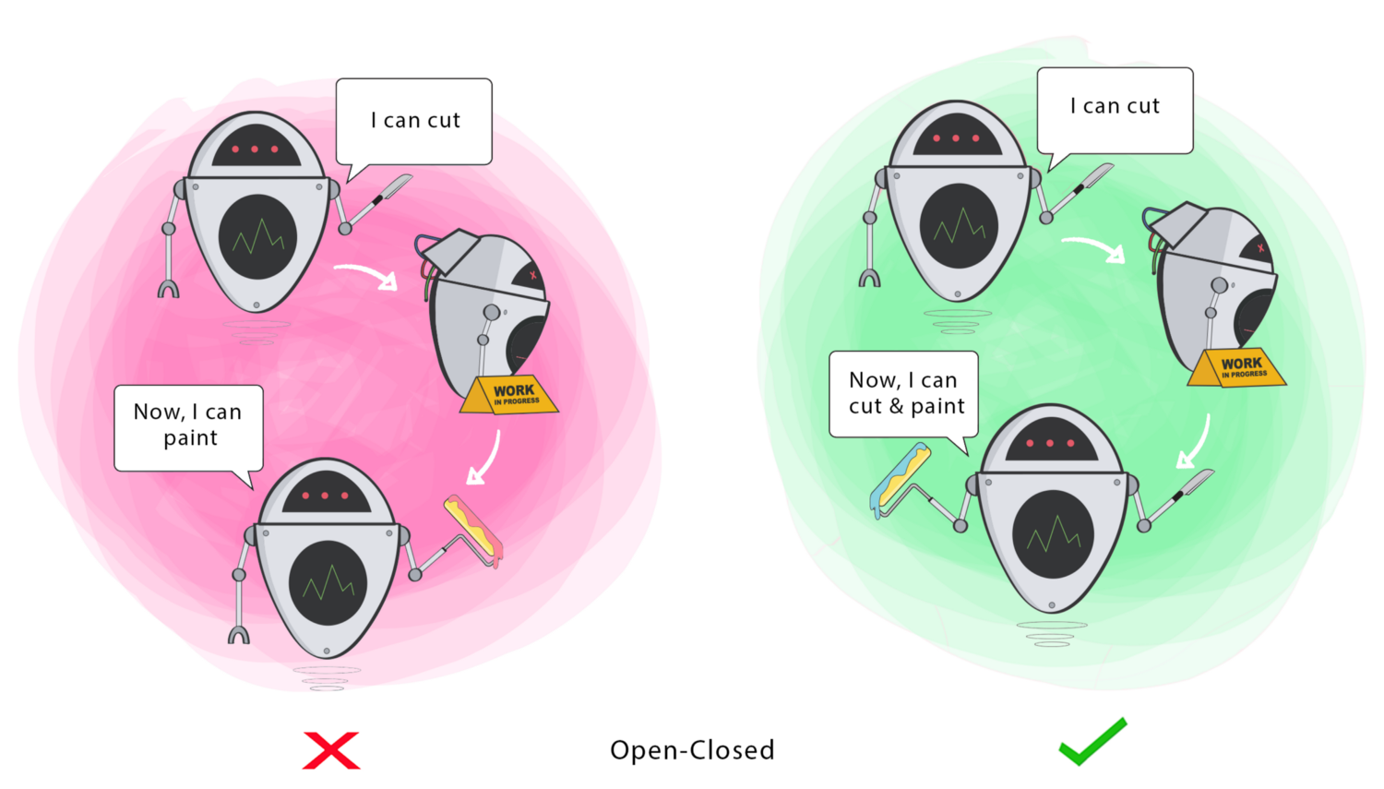
Open-closed principle
“Each module should be open for change but close for modification”
The goal of this principle is to extend a module’s behaviour without changing the existing behaviour of the module and avoid causing bugs with changes.

Slide 14
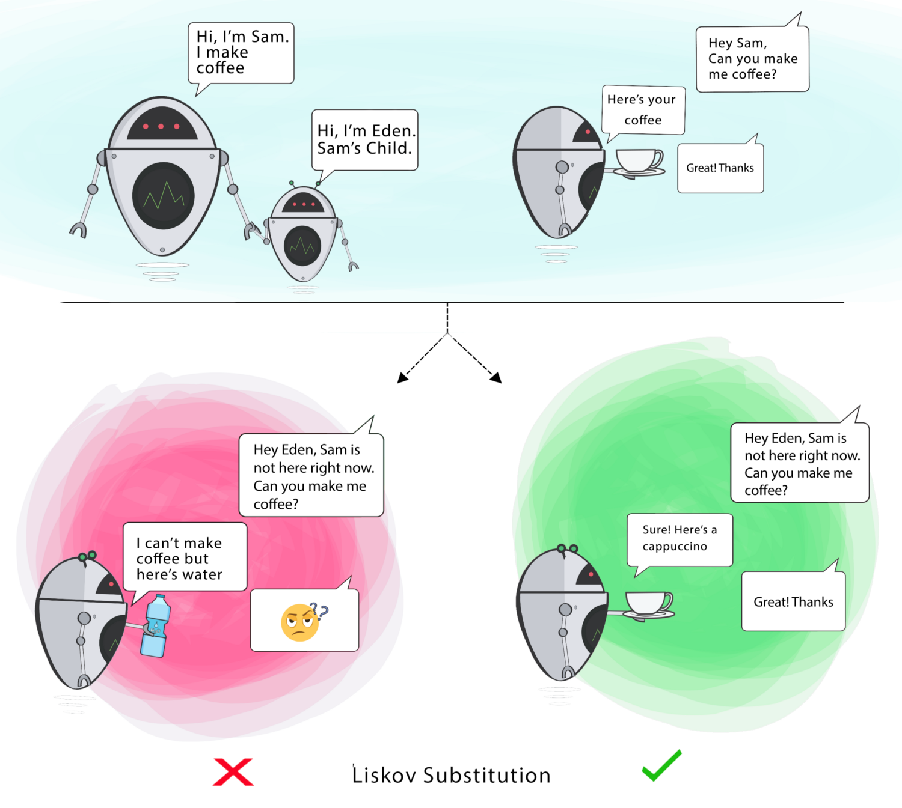
Liskov substitution principle
“You should be able to use any derived class instead of a parent class and have it behave in the same manner without modification”
It ensures that a derived class does not affect the behavior of the parent class – a derived class must be substitutable for its base clase.

Slide 15
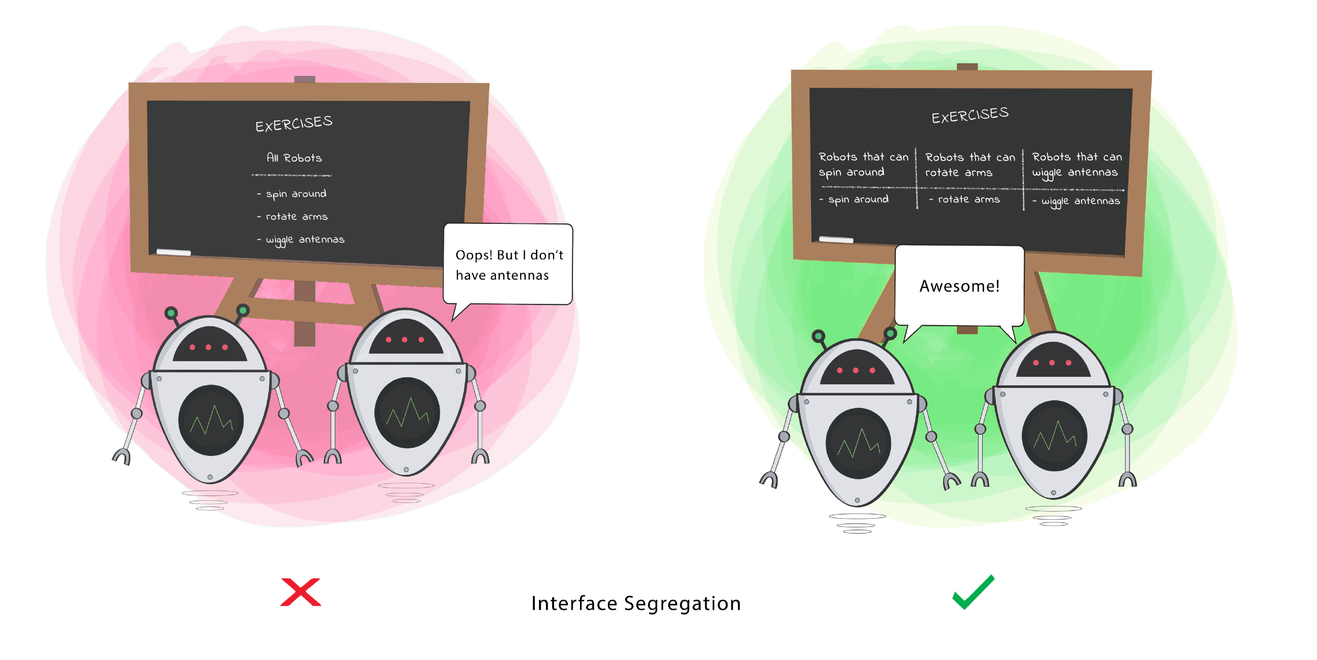
Interface Segregation principle
“Clients shouldn’t be forced to implement interfaces they don’t use”
An interface should be more closely related to the code that uses it than code that implements it. So the methods on the interface are defined by which methods the client code needs rather than which methods the class implements.

Slide 16
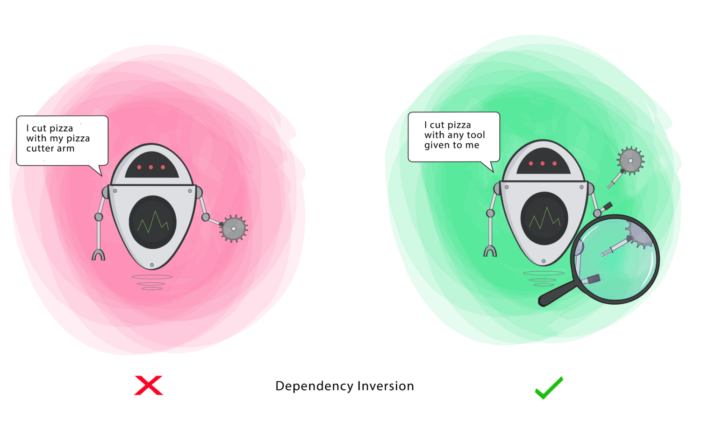
Dependency inversion principle
“High-level modules shouldn’t depend on low-level modules”
High-level modules implement business rules or logic in a system while low High and low level modules, as well as details, should depend upon abstractions.

Slide 17
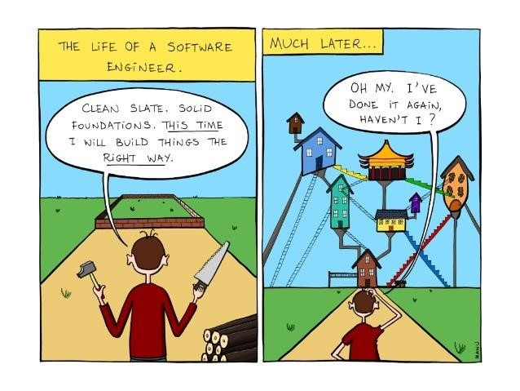
Design patterns
05

Slide 18
Design patterns
Design patterns are solutions to commonly occuring problems in software design. They aren’t a specific pieces of code, but a general concept for solving a particular problem.
Intent of the pattern briefly describes both the problem and the solution
Motivation further explains the problem and the solution the pattern makes possible
Structure of classes shows each part of the pattern and how they are related
Code example in one of the popular programming languages for easier understanding

Slide 19
The Gang of four patterns
Creational patterns
Abstract factory
Factory method
Builder
Prototype
Singleton
Structural patterns
Adapter
Bridge
Composite
Decorater
Facade
Flyweight
Proxy
Repository pattern
Can be viewed as a special kind of Facade, special kind of Factory and a special application of Iterator
Behavioral patterns
Chain of responsibility
Command
Interpreter
Iterator
Mediator
Memento
Observer
State
Strategy
Template method
Visitor

Slide 20
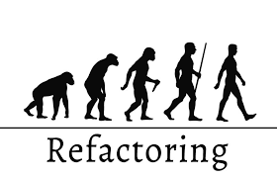
refactoring
06

Slide 21
refactoring
The main purpose of refactoring is to fight technical debt. It transforms a mess into a clean code and simple design.
Clean code
Poor variable naming, bloated classes and methods
Doesn’t contain duplication
Code is easier and cheaper to maintain
Passes all tests
Technical debt
Rolled out features which aren’t completely finished
Lack of documentation
Lack of tests
Long-term simultaneous development on several branches
Delayed refactoring

Slide 22
When to refactor
Rule of three
When doing something for the first time
When doing something similar for second time
When doing something for the third time
When adding a feature
It will help you understand other people’s code
It will make adding new features easier
When fixing a bug
Clean your code and the errors will practically discover themselves
During code review
Best way is to perform review in a pair with an author so you can fix simple problems quickly Proxy

Slide 23
Questions

Slide 24
Thank you
SERBIA / NOVI SAD
Levi9 Global Sourcing Balkan d.o.o.
Novi Sad Offices
Trifkovićev Trg 6
21000 Novi Sad, Serbia

